Slide 1
Module XVI Emergency preparedness and response
Name of Lecturer
Organization
Email address
Notes:
Instructions for the Lecturer:
Unit 1 – on basic concepts and planning basis for preparedness and response for a nuclear or radiological emergency, with focus on nuclear emergencies (at facilities in EPC I and II)
Time allocated – 80 minutes, number of ‘active’ slides: 55 of 67
Last slide: 10 minutes discussions

Slide 2
Structure of the Module
Structure | Title | Description
Unit 1 | Basic concepts and planning basis for preparedness and response for a nuclear or radiological emergency | Lecture 80 minutes presentation 10 minutes discussions
Unit 2 | Functional and infrastructural elements for emergency preparedness and response” | Lecture 80 minutes presentation 10 minutes discussions
Unit 3 | Role of the IAEA on preparedness and response for a nuclear or radiological emergency ” | Lecture 75 minutes presentation 15 minutes discussions
Unit 4 | Case studies on preparedness and response for a nuclear emergency | Practical session 90 minutes

Slide 3
Unit 1:
Basic concepts and planning basis for preparedness and response for a nuclear or radiological emergency
Name of Lecturer
Organization
Email address
Notes:
Instructions for the Lecturer:
Unit 1 – on basic concepts and planning basis for preparedness and response for a nuclear or radiological emergency, with focus on nuclear emergencies (at facilities in EPC I and II)
Time allocated – 80 minutes, number of ‘active’ slides: 55 of 67
Last slide: 10 minutes discussions

Slide 4
Learning objectives
To understand the basics concepts used in preparedness and response for a nuclear or radiological emergency
To understand the goals for emergency preparedness and response for a nuclear or radiological emergency
To understand the planning basis that has to be established for developing emergency response capabilities for a nuclear or radiological emergency

Slide 5
Contents
1. Basic concepts
  Basics of radiation protection
  Types of releases, exposure pathways and protective actions
  Dose calculations and field monitoring
  Goals of emergency preparedness and response
2. Planning basis
  Assessment of hazards
  Concept of operations
  Protection strategies
  Planning levels and responsibilities
  Establishing emergency response capabilities

Slide 6
Basic concepts:
Basics of radiation protection

Slide 7
Types of exposure situations
Planned exposure situations
  Planned operation with source that results in (controlled) exposure
Emergency exposure situations
  Result of an accident, malicious act or any other
  Requires prompt action
Existing exposure situations
  Already exist when a decision on control has to be taken
  Include prolonged exposure situations after emergencies
Notes:
A distinction is made between types of exposure situations and categories of exposure. There are three types of exposure situations, as described in the ICRP Publication 103 and IAEA Safety Standard GSR Part 3: planned exposure situations, emergency exposure situations and existing exposure situations. Planned exposure situations are situations involving the deliberate introduction and operation of sources. Emergency exposure situations are situations that may occur during the operation of a planned situation, or from a malicious act, or from any other unexpected situation, and require urgent action in order to avoid or reduce undesirable consequences. Existing exposure situations are exposure situations that already exist when a decision on control has to be taken, including prolonged exposure situations after emergencies.
The three broad categories of radiation exposure are: occupational, public and medical.

Slide 8
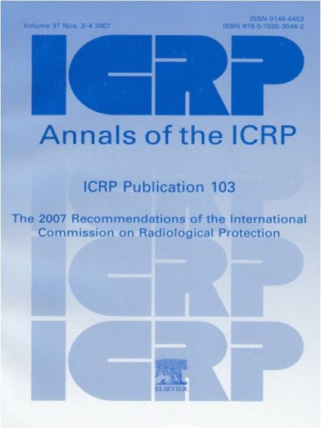
Principles of radiation protection
Justification
  No practice unless it is justified
  During emergency exposure: any protective actions or remedial actions should do more good than harm
Optimization
  For all exposure situations: optimization of protection and safety
  In emergency exposure situations: as low as reasonably achievable (ALARA)
Dose Limits
  In planned exposure situations
  Other than medical
  Avoid the excess of dose limits
Image courtesy ICRP

Slide 9
Optimization of radiation protection
In planned exposure situations
  Dose constraints
In emergency and existing exposure situations
  Reference levels = levels of dose
    above which it is unacceptable to plan to allow exposures to occur → protective actions to be implemented
    below which – the ALARA principle has to be applied
Chosen value will depend upon prevailing circumstances
Used in designing and selecting protection strategies

Slide 10
Types of health effects
Deterministic: for which a threshold level of dose exists:
  Below the threshold - there is no effect
  Above the threshold - the severity increases with the dose received
  Threshold differs for different organs and effects
  Many cells die or have altered function
  Fatal or life threatening or results in a permanent injury
  Reduced quality of life

Slide 11
Types of health effects – cont’d
Stochastic: generally occurs without a threshold level of dose
  No threshold level of dose
  Probability proportional to the dose
  Severity independent of the dose
  Latency period of several years for cancer
  Includes radiation induced cancers, leukemia and hereditary effects

Slide 12
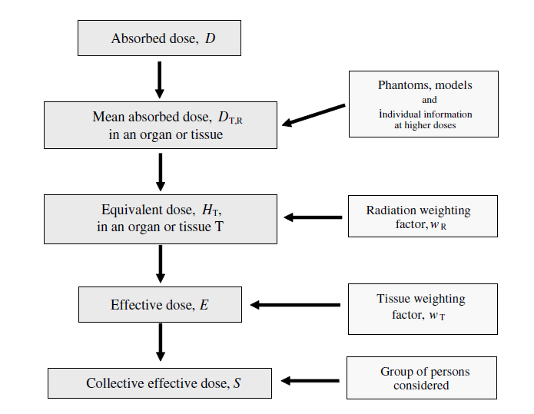
Dosimetric quantities for radiation protection
Notes:
In order to evaluate radiation induced health effects, dosimetric and radiation protection quantities and units are used. The absorbed dose is the fundamental dosimetric quantity which quantifies the mean energy imparted to a target volume of matter by any type of ionizing radiation. Special radiation protection quantities are derived from the absorbed dose, by weighting the absorbed dose with specific weighting factors (radiation weighting factors, tissue weighting factors, RBE weighting factors). To evaluate stochastic effects that develop due to exposure of an organ, the equivalent dose in the organ or tissue is used. For evaluating deterministic effects due to exposure of an organ, the RBE-weighted absorbed dose (RBE-weighted dose) in the organ or tissue is used. To estimate the total radiation risk, the effective dose is used.
For planning and response to emergency exposure situations, a conceptual set of doses (effective and/or equivalent doses) is defined and has to be used in the justification and optimisation of protection strategies, emergency plans and decisions: projected dose, residual dose and averted dose. Their definitions and use will be presented in more detail when addressing the protection strategies.

Slide 13
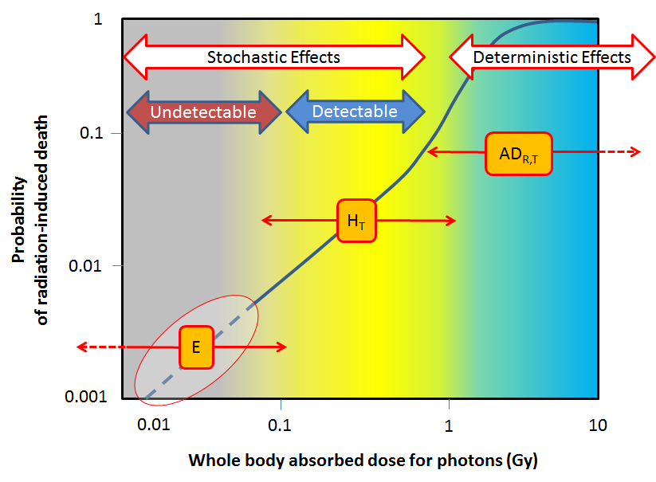
Application of dosimetric quantities

Slide 14
Basic concepts:
Types of releases, exposure pathways and protective actions

Slide 15
Types of releases
Nuclear accidents can produce two types of releases:
  Airborne releases: release of radioactive material into the atmosphere, forming a plume and producing ground contamination
  Liquid releases: the radioactive material is discharged into water bodies (ground water, rivers, lakes and the sea)
Notes:
An emergency at a nuclear power plant can result in a significant amount of radioactive material being released. There are two types of releases:
- Airborne that goes into the atmosphere, forming a plume, which consists of radioactive gases, aerosol particles and water vapour. This was the main release in the Chernobyl emergency for example.
Liquid is discharged into water bodies (rivers, lakes, and the sea). The Fukushima Daiichi NPP emergency can serve as an example for involving such release.
Usually the main concern is the airborne release due to exposure of population to plume with possible serious consequences.
For the most severe releases, deterministic effects can only be prevented by taking protective actions before or shortly after a beginning of release.
The contamination due to liquid discharges is considered almost negligible compared to the airborne release in this respect.
Radionuclides are released to the environment as
- Gases (Xe, Kr, I₂),
- Aerosol particles in the air
- Water soluble particles (caesium iodide (CsI), caesium hydroxide (CsOH), strontium hydroxide (Sr(OH)₂) and
- Slightly soluble oxides of tellurium, ruthenium and lanthanum.
An aerosol is a colloid of fine solid particles or liquid droplets, in air or another gas. Examples of aerosols include haze, dust, particulate air pollutants and smoke. Mist and clouds are aerosols.

Slide 16
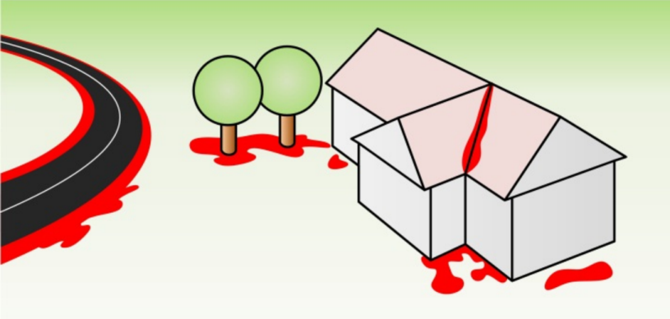
Ground contamination
The plume will travel downwind and the concentration of radioactive materials will tend to decrease in the air, as it travels further from the facility → the external dose from the plume (cloud shine) and the inhalation dose will also decrease with distance
Depositions on the ground will become then the main risk for external exposure and for contamination
Depositions can be increased by precipitation (rain)
  Washes down radionuclides
  Hot spots along the rain path
Hot spots = areas with higher
radiation or contamination levels
Notes:
As the plume travels, radioactive material is deposited on the ground, buildings, roads, playgrounds, gardens, parks etc. This is called ground contamination or deposition.
Deposition from severe releases may occur at a considerable distance. The plume will travel downwind and the concentration of radioactive materials will tend to decrease as it travels further from the facility. As the concentration of radioactive materials in the plume decreases, the dose rate to the affected population will also decrease. Thus, those who are further away from the plant will generally be at less risk, i.e. stochastic effects not warranting immediate evacuation but relocation or restrictions on food consumption.
The deposition of radioactive material can be increased by precipitation (e.g. rain), which washes down radionuclides from the air to the ground, where, in addition, hot spots are formed along the rainwater path.
These are areas with higher radiation or contamination levels.

Slide 17
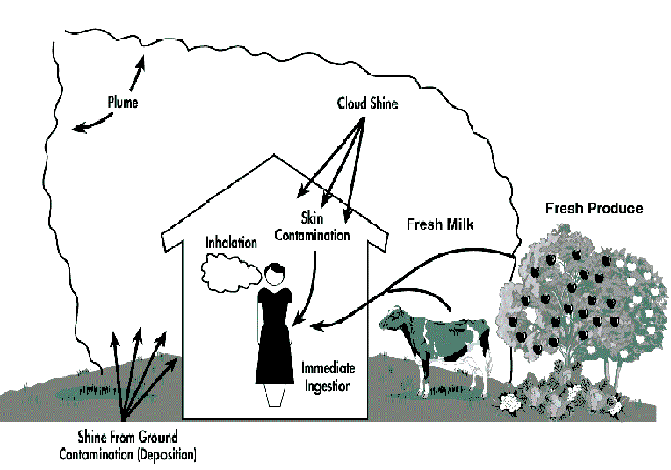
Exposure pathways
External exposure
Inhalation
Ingestion
Contamination of skin and clothing
Notes:
The ways in which people can be exposed to radiation in the case of a nuclear or radiological emergency are referred to as exposure pathways and include: external exposure from contact with or being in proximity to a source of radiation (e.g. a source, a plume containing radioactive material or ground deposition of radioactive material); ingestion (e.g. of contaminated food, milk or water, inadvertent ingestion of contamination on hands); inhalation from a plume or due to the resuspension of deposited radioactive material; and contamination of skin/wounds and clothing.
A clear distinction is to be made between exposure and contamination. When somebody is exposed to radiation, there is no transfer of radioactive material. On the other hand, contamination implies deposition of unwanted radioactive material on surfaces or on/inside the human body.

Slide 18
Sheltering
Protects against external radiation
Some protection against inhalation
Effectiveness depends on type of dwelling or structure
Duration limited to about 2 days
Must be prompt
Note that sheltering may lead to spontaneous evacuation

Slide 19
Evacuation
Evacuation during a release (even in a plume) is better than or as good as:
  Shelter in normal houses within 5 km
  Substantial shelter (inside large buildings) within 1-2 km
Must be timely to avoid external radiation

Slide 20
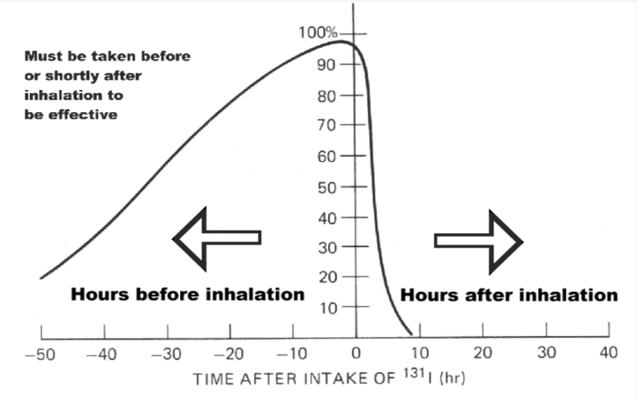
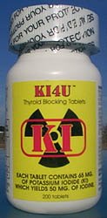
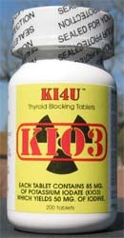
Thyroid blocking
100 mg of Iodine ≈ 130 mg of KI
Thyroid blocking (administration of stable iodine)
  Protects the thyroid against accidental releases containing radioactive iodine
  Is considered to be primarily effective for reduction of inhaled iodine

Slide 21
Restriction of food consumption
Applied in the majority of reactor emergencies
Can be expensive
Potential detriment to farmers could necessitate compensation costs
Alternate food supplies may be required
Potential loss of confidence in food supplies

Slide 22
Relocation & resettlement
Purpose of longer-term protective actions
  To reduce risk of stochastic effects in exposed population
Relocation
  Temporary action to avoid unnecessary high doses occurring over a period of time (e.g., months, years)
Resettlement
  Lifelong action to avoid high individual doses

Slide 23
Public monitoring and decontamination
Public should be monitored
Monitoring should not delay evacuation
Instruct people to take personal protective actions
  No eating, drinking or smoking in contaminated areas
  Individual decontamination such as showering and changing clothes

Slide 24
Protection of emergency workers
Emergency workers (including off-site responders) must
  Be trained
  Monitor dose
No emergency worker shall be exposed in excess of maximum single year dose limit for occupational exposure except
  In case of life saving or preventing serious injury
  If to avert a large collective dose
  When the development of catastrophic conditions must be avoided
Notes:
The topic will be addressed once more under Unit 2.

Slide 25
Basic concepts:
Dose calculations and field monitoring

Slide 26
Dose projections models
Primary role of dose projections:
  To determine the extent of required protective actions or
  To support the analysis that no action is required
Dose projections are performed by using mathematical models
  Dose prediction models based on source term estimation
  Dose prediction models based on environmental monitoring data
Dose projection models are useful tools
  At the planning stage
  Also during response phase, but not in the very first hours of an emergency!

Slide 27
Assumptions for calculations
Assumptions (so called “input parameters”) to be made when calculating doses:
  Source term
  Release characteristics
  Atmospheric dispersion
  Dosimetry related parameters
Might not be available in the urgent phase
Uncertainties in predicting the source term might significantly impact on the results of modelling

Slide 28
Source term
Type and quantity of radioactive materials (fission products and transuranic elements) released from the core of a reactor
Depends on:
  Reactor design
  Operating power at the time of the accident
  Fuel type
  Degree of fuel damage
  Degree of containment damage
  Degree of damage of other reactor components (sprays, filters, etc)

Slide 29
Model uncertainties
Source term uncertainties
  Controlled stack release – vary by a factor of 2 to 3
  For uncontrolled release – vary by one to three orders of magnitude
Release uncertainties
Atmospheric dispersion modelling uncertainties
Dosimetry related uncertainties
Don’t use them during the urgent phase of the response!
  Dose projections models based on source term estimation cannot be effectively used for making decisions during the urgent phase

Slide 30
Use of models
Models are useful during the planning / preparedness phase
  To develop appropriate protection strategies for emergencies consequent to severe nuclear accidents
Experience from Chernobyl and Fukushima Daiichi NPPs emergencies
  Location, size and timing of the releases were not predicted
  Releases occurred over a period of days to weeks
  Release rates and compositions could not be assessed by the control room operators; they were assessed later on, based on measurements

Slide 31
Dose calculations based on measurements
Calculate doses starting from isotopic concentrations measured in air or on ground
  Usually: ground shine, cloud immersion, inhalation and total effective doses are computed
  For pre-defined integration times
Dose computations and dose factors are the same as in source term estimation models

Slide 32
Dose calculations and field monitoring
After urgent protective actions are implemented
  To assess areas warranting early protective and other response actions
Model projections
  Helpful to direct monitoring efforts
  But actions not to be limited to model projections!
Actual field monitoring results
  Can differ considerably from calculations
  Calculations show averages, not hot spots
Notes:
Let’s now look how dose calculations can be useful in spite of the associated uncertainties.
After the urgent protective actions have been implemented, the next step is to assess the areas that may warrant implementation of early protective and other response actions, i.e. the feedback should be provided regarding the magnitude and composition of a release based on the analysis of off-site samples and field monitoring results.
After the release, dose calculation models may be useful in initially directing resources for off-site monitoring and sampling; however they are not substituting the need to carry out field monitoring in all directions close to the nuclear power plant and not just in those areas indicated by models.
One must be sensitive enough to the differences between actual plume behavior and that simulated by the models. Even if the model projections are “correct”, actual field monitoring results can differ considerably from the calculations because the calculations show averages, e.g. do not show hot spots (areas with high levels of contamination). Even under best circumstances it would be quite optimistic to expect field monitoring results to agree with model calculations.

Slide 33
Basic concepts:
Goals of emergency preparedness and response

Slide 34
Goals of emergency response
To regain control of the situation and to mitigate consequences
To save lives
To avoid or to minimize severe deterministic effects
To render first aid
  Provide critical medical treatment
  Manage the treatment of radiation injuries
To reduce the risk of stochastic effects

Slide 35
Goals of emergency response – cont’d
To keep the public informed and maintain public trust
And to the extent practicable:
  To mitigate non-radiological consequences
  To protect property and the environment
  To prepare for the resumption of normal social and economic activity

Slide 36
Goal of emergency preparedness
An adequate capability is in place for an effective response in a nuclear or radiological emergency
  At the operating organization
  At local, regional and national levels and
  Where appropriate, at the international level
An integrated set of infrastructural elements is in place, like:
  Authority and responsibilities
  Organization and staffing
  Coordination
  Plans and procedures
  Tools, equipment and facilities
  Training, drills and exercises, and
  A management system

Slide 37
Planning basis:
Assessment of hazards

Slide 38
Assessment of hazards
The process of analyzing systematically the hazards associated with facilities, activities or sources within or beyond the borders of a State in order to identify:
  (a) events and associated areas for which protective actions may be required within the State;
  (b) actions that would be effective in mitigating the consequences of such events
Notes:
Definition according to IAEA Safety Glossary
Module No.6. Threat assessment

Slide 39
Assessment of hazards – cont’d
Provides for a graded approach for emergency planning: the nature and extent of emergency arrangements commensurate with the potential magnitude and nature of the hazard associated with the facility or activity
To be conducted (and periodically reviewed) by:
  - Operators of facilities and activities and
  - National Coordinating Mechanism, with support from other appropriate national organizations (including the Regulatory Body)

Slide 40
Emergency Preparedness Categories
[from Table 1, GSR Part 7]
Cat. | Description
I | Associated with facilities in which severe deterministic effects off-site are possible (e.g. reactors > 100 MW(th))
II | Associated with facilities that can warrant urgent protective actions off-site but severe deterministic effects are only possible on-site (e.g. reactors 2 – 100 MW(th)
III | Associated with facilities that can only warrant urgent protective actions on-site, severe deterministic health effects are possible only on-site (e.g. radiotherapy facility)
IV | Associated with activities and sources leading to an emergency at any location (e.g. mobile industrial radiography, transport)
V | Associated with areas affected by a transboundary contamination necessitating prompt response (areas within emergency planning zones and distances of neighboring NPP)
Notes:
GSR Part 7: “For the purposes of these safety requirements, assessed hazards are grouped in accordance with the emergency preparedness categories shown in Table above. The five emergency preparedness categories (hereinafter referred to as ‘categories’) in the table above establish the basis for a graded approach to the application of these requirements and for developing generically justified and optimized arrangements for preparedness and response for a nuclear or radiological emergency.”
Facilities and activities are grouped into five EPCs, based on common features in terms of the magnitude and timing of the hazard and corresponding stringency of requirements for preparedness and response arrangements (Table I of GSR Part 7)
For each EPC – specific:
- planning
- concept of operations
- arrangements for preparedness
- on-site and off-site response actions

Slide 41
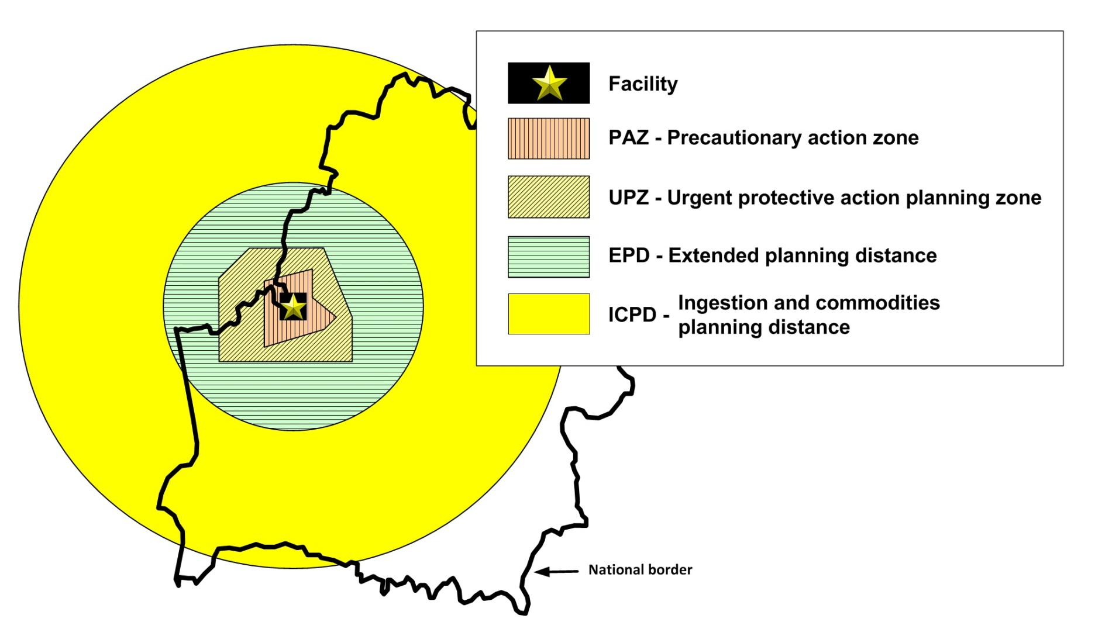
Emergency Planning Zones and Distances
[EPR-NPP PPA Section 4, Fig. 4 and Table 3]
 | Power MW(th)
 | ≥ 1000 MW(th) | 100 to 1000 MW(th)
PAZ | 3 to 5 km
UPZ | 15 to 30 km
EPD | 100 km | 50 km
ICPD | 300 km | 100 km
Images courtesy IAEA
Notes:
In addition to an emergency classification system, off-site emergency zones and distances around the nuclear power plant need to be identified in advance during the preparedness stage. This is to ensure that effective protective actions and other response actions can be promptly implemented to protect the public that are consistent with the hazard. Four areas need to be defined:
Precautionary action zone (PAZ);
Urgent protective action planning zone (UPZ);
Extended planning distance (EPD); and
Ingestion and commodities planning distance (ICPD).
The emergency zones and distances are described in EPR-NPP PPA(Table 2) and the suggested sizes for the zones and distances are given in Table 3. The size and boundaries of the zones and distances need to be site specific. The sizes of the zones and distances given in Table 3 are to be considered as a first approximation that needs to be adjusted to specific plant designs, emergency scenarios and local conditions.

Slide 42
Planning basis:
Concept of operations

Slide 43
Concept of operations
A brief description of the response to an emergency
To be developed at the beginning of the preparedness process to ensure that all those involved in the development of a response capability share a common vision
To be used when planning the response, for:
  Allocation of roles and responsibilities
  Development of emergency response plans at all levels: national, local, on-site

Slide 44
The Operator: response actions for EPC I and II
Classify an emergency
Mitigate the emergency
Notify and recommend protective actions off the site consistent with national planning
Protect those on site
Obtain off-site assistance
Conduct environmental monitoring near the facility and
Assist off-site officials in keeping the public informed
Notes:
The response actions provided in this slide, together with allocated response time objectives are to be used when developing concept of operations for responding to emergencies in EPC I and II.
Module No.15: Concept of operations for threat category I
IAEA Training in Emergency Preparedness and Response

Slide 45
Off-site officials: response actions for EPC I and II
Implement urgent protective actions within the emergency zones
Control consumption of contaminated food within the ICPD
Provide emergency services to the facility
Provide medical treatment to contaminated or overexposed victims
Tell the public and media in plain language of the risk, and of the action they should take and
Monitor and respond to inappropriate public reactions
Notes:
The response actions provided in this slide, together with allocated response time objectives are to be used when developing concept of operations for responding to emergencies in EPC I and II.

Slide 46
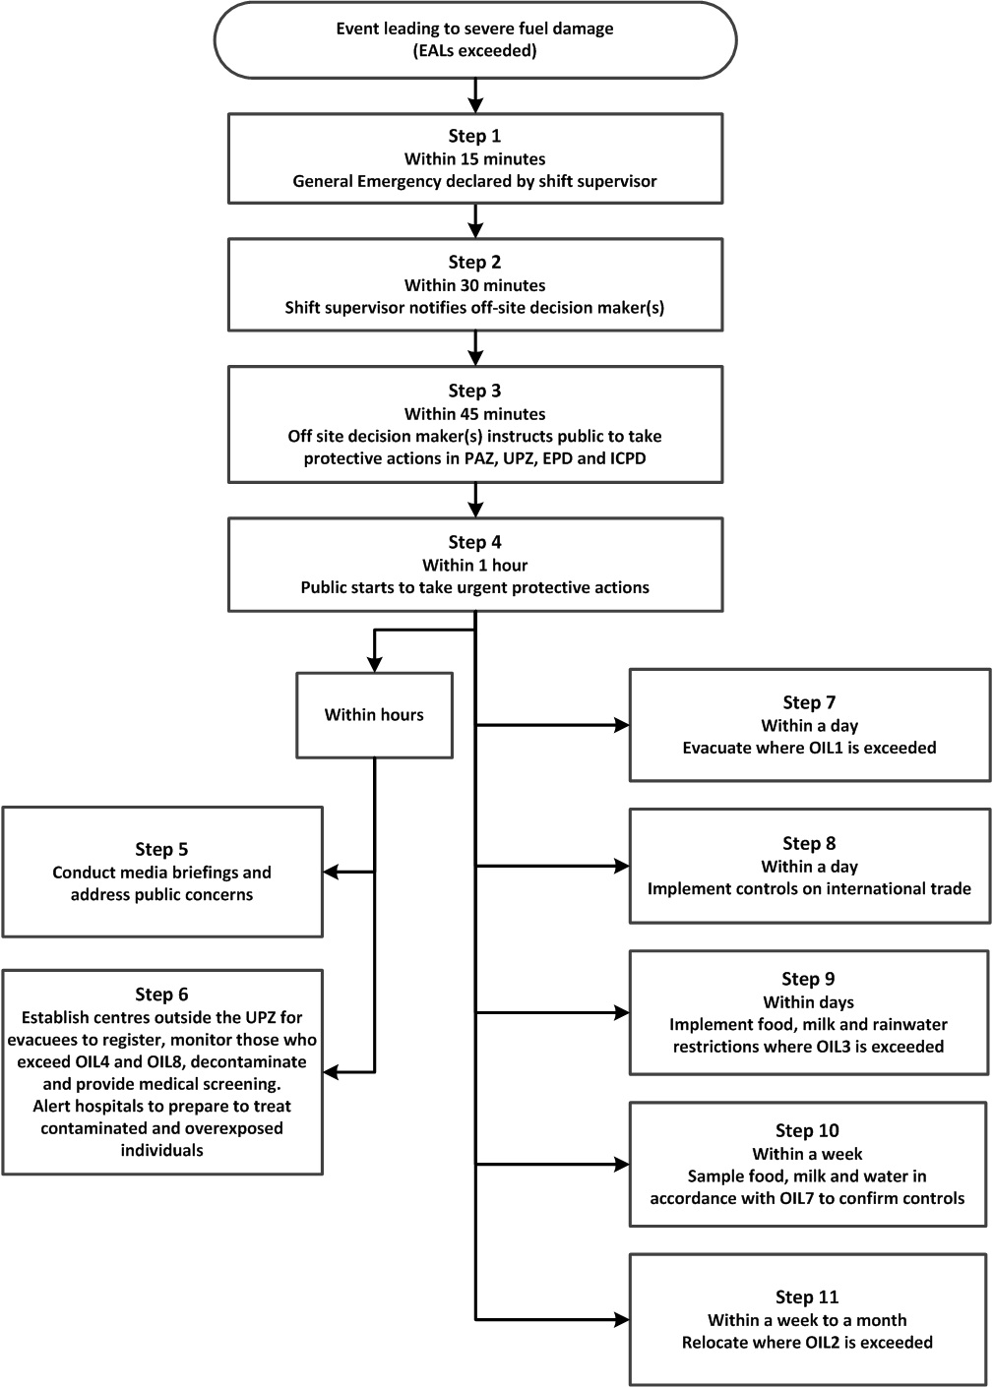
Generic concept of operations for EPC I and II
Notes:
EPR-NPP-PPA 2013: The concept of operations presents an example of a response taken in the event of a severe emergency involving actual or projected severe damage to the fuel in a reactor core or spent fuel pool. This concept of operations is a starting point and operators and off-site officials need to adapt it to local conditions in order to be effective.

Slide 47
Emergency classification system
Triggers fast and coordinated on- and off-site response based on emergency action levels (EALs - i.e. pre-determined observable thresholds)
Class | Plant conditions | Protective actions off site
General emergency | May not be safe off site Projected or actual severe damage to fuel Loss of control | Immediate urgent protective action
Site area emergency | If additional failures → severe damage to fuel | Alert officials and public to prepare Off-site monitoring
Facility emergency | On site risk only | None
Alert | Degraded or uncertain conditions - no known danger to fuel | None

Slide 48

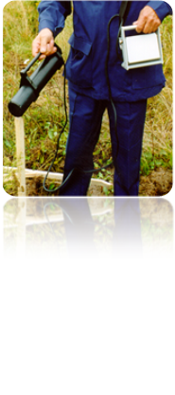
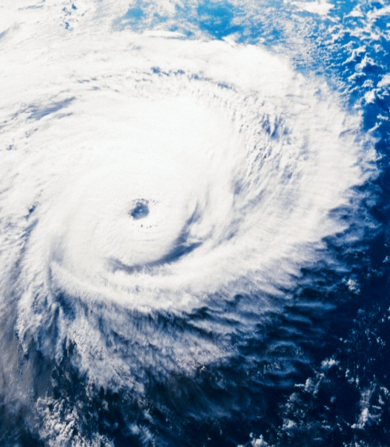
Emergency Action Levels (EALs)
Trigger for classification of the emergency
Predetermined threshold observable during emergency conditions
Plant conditions
(e.g. SF loss)
Radiological monitoring
Other hazards/
threats

Slide 49
Planning basis:
Protection strategies

Slide 50
Protection Strategy
Justified and optimized set of protective actions and other response actions designed to achieve effectively the goals of emergency response
Generic approach aimed:
  To define implementation of effective and efficient protective actions
  To guide establishment of adequate emergency arrangements

Slide 51
Protection Strategy – cont’d
Developed at the preparedness stage with involvement of all relevant interested parties
  Basis for emergency arrangements
Implemented safely and effectively in response to an emergency
  Through execution of pre-established emergency arrangements
Adjusted as the emergency evolves, to meet the actual conditions

Slide 52
Dose concepts for the strategy
Projected dose: individual effective (or equivalent) dose that is expected to be received if no protective actions are implemented
Residual dose: the dose expected to be incurred after protective actions have been terminated (or after a decision has been taken not to take protective actions)
Received dose: the dose that has been received by a person from exposure to an actual situation

Slide 53
Use of dose concepts for strategy development
Generic criteria
Projected dose
Basis to implement protective actions
Generic criteria
Received dose
Basis to implement medical actions
Reference level
Residual dose
Basis to optimize and to judge effectiveness of strategy

Slide 54
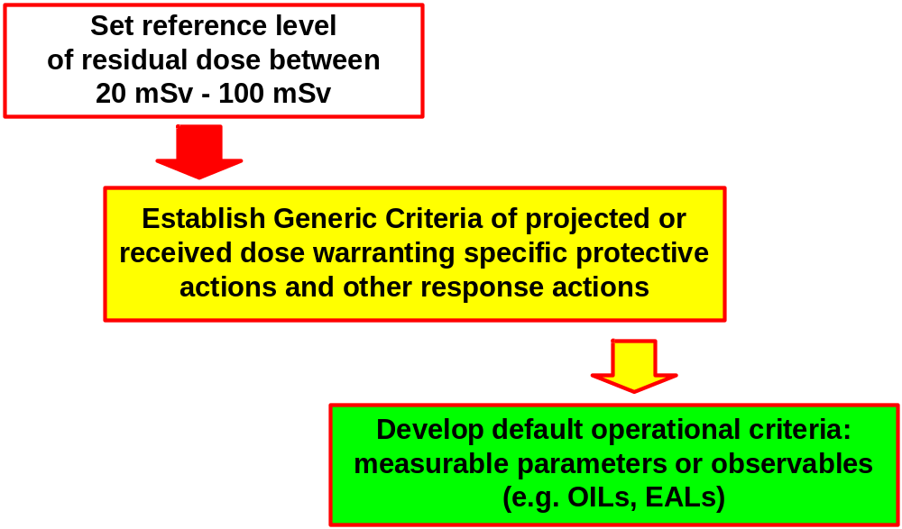
Protection Strategy: reference levels and generic criteria
Reference level
of residual dose
100 mSv
 | Emergency exposure situation
20 mSv 1 mSv | Existing exposure situation
 | Planned exposure situation

Slide 55
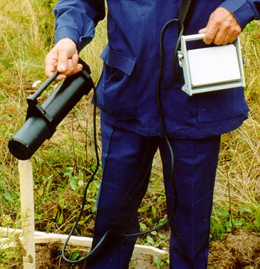
Operational Interventional Levels (OILs)
Predetermined level of a measurable quantity to trigger response actions (based on GC) on the basis of monitoring and sampling:
Default OIL value exceeded
Immediate action

Slide 56
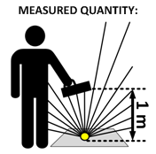
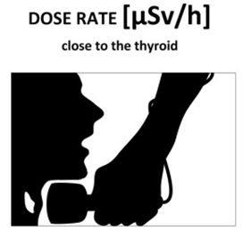
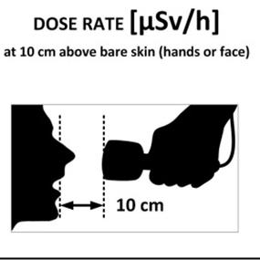
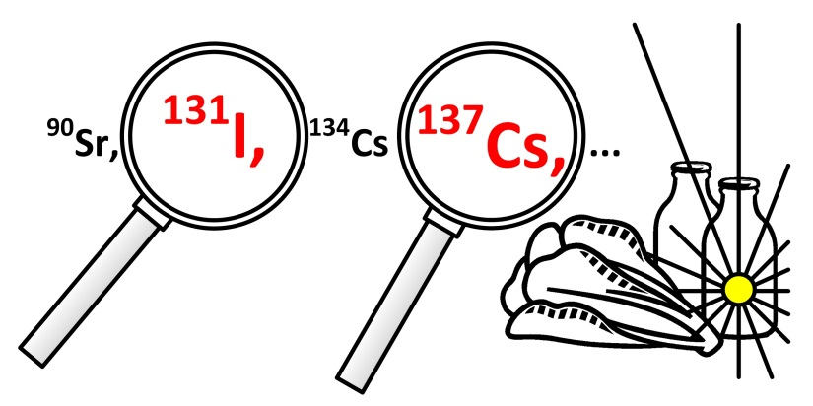
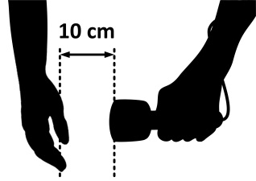
Default OILs are provided for:
Dose rate above the ground
Dose rate from
the thyroid
For:
evacuation
relocation
food restrictions
Dose rate
from skin contamination
Food, milk
and water
Cs-137
and I-131
concentrations
Notes:
In Section 6 of EPR–NPP PUBLIC PROTECTIVE ACTIONS default OILs are provided for use following a release from a nuclear power plant core or spent fuel pool.
OILs are provided for:
dose rate above the ground for determining if evacuation, relocation or food restrictions are warranted;
dose rate from skin contamination to determine if decontamination or medical follow-up is warranted;
dose rate from the thyroid to determine if medical follow-up is warranted;
concentrations of cesium-137 and iodine-131 in food, water and milk to determine if restrictions are warranted.

Slide 57
What to know in order to optimize
Dominant exposure pathways
    Will guide decisions on the types of protective measures allocated
    Resources should be commensurate with the expected benefits
Time scales over which components of the dose will be received
Potential effectiveness of individual protective measures
    Social and economic consequences in addition to dose effectiveness

Slide 58
Planning basis:
Planning levels and responsibilities

Slide 59
Three levels of planning and responsibilities
OPERATOR (facility staff) | OFF-SITE (local and national authorities) | INTERNATIONAL (IAEA)
Mitigate the emergency Protect people on-site Notify and keep off-site authorities informed, including international community Provide initial radiological monitoring, etc. | Implement protective actions off-site Provide support to the facility Public communication Provide medical treatment Notify IAEA, etc. | Notify and exchange official information among international community Provide advice and assistance if requested Perform assessment of the situation and prognosis of its development Provide information to general public and media, and Coordinate the inter-agency response
Notes:
There are three levels of responsibilities.
- The responsibilities of operator and
- off-site authorities are clearly outlined in the description of the concept of operations.
- But as we have learned from past emergencies, severe nuclear accidents are by no means limited to national borders. The Chernobyl and Fukushima accidents had both global impacts. Therefore there is international level as well. Summary of all three levels and basic responsibilities is given in the table. Here, at international level, the focus is kept on the IAEA responsibilities in emergency response only.

Slide 60
Operators, local and national officials
Establish and maintain emergency plans and arrangements for preparedness and response
Demonstrate effectiveness of emergency arrangements
Coordinate the on-site response with the off-site response, ensure harmonization of response within the national system

Slide 61
Dual role of the Regulatory Body (RB)
  As REGULATOR
    To regulate, authorize and control facilities and activities in the nuclear field
  As RESPONSE ORGANIZATION
    To provide advice and expert services on EPR at national level
    To coordinate preparedness with other response organizations

Slide 62
Planning basis:
Establishing emergency response capabilities

Slide 63
National radiation emergency plan (NREP)
Overall umbrella emergency response plan
  For all responding organizations and their relationships
Should provide sufficient detail to ensure effective response
Usually a part of “all hazards” plan
  Otherwise must address the integration under ‘all-hazards’ approach
Notes:
The NREP is an overall umbrella plan for all responding organizations and their relationships. In particular, the NREP should provide sufficient detail to ensure that functional areas covered by emergency teams from different ministries or organizations can function effectively. The NREP is a summary of more detailed implementation plans and ensures that all the other planning is integrated and compatible.
The national radiation emergency response plan (NREP), which usually covers nuclear and radiological emergencies, would preferably be a part of “all hazards” plan, which is the national emergency plan or set of plans for an integrated response to any type or combination of hazards or disasters. If there is no national “all hazards” plan, the NREP must address in detail the integration with the response of other organizations during emergencies involving a combination of actual or perceived hazards.

Slide 64
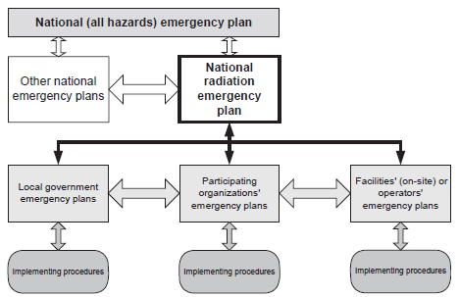
Integrated planning (all hazards approach)
Notes:
A radiation emergency may be caused by or may involve different types of hazards, including natural, technological, or criminal or malicious activities. The response to each of these hazards involves various response organizations with their own response capabilities and plans.
Consequently, the capabilities, plans and procedures for response to all hazards should be structured into a coherent and interlocking system, by using the all hazards approach.
In terms of planning, at the top level should be a national emergency plan for an integrated response to any combination of hazards. The national radiation emergency plan (NREP) will be a part of this “all hazards” plan.

Slide 65
Ten steps for developing the NREP
Tasks | Implementation Time
Designate National Radiation EPC
1. Review national policy
2. Perform hazard assessment
3. Develop planning basis
4. Allocate responsibilities
5. Develop interim capability
6. Write NREP
7. Present NREP
8. Implement detailed plans
9. Test capability
10. Establish ongoing QM programme

Slide 66
Establishing response capabilities
Operators and response organizations involved in the NREP have to develop detailed emergency response plans to fulfil their responsibilities, in close coordination
All organizations develop arrangements, functional elements and infrastructure capabilities to address their roles and responsibilities and implement the NREP
Notes:
Operators and response organizations develop the functional and infrastructural elements needed to implement the NREP for each facility and jurisdiction identified as part of the hazard assessment. Capabilities should be developed to address the elements appropriate for the category of the practice or facility and jurisdiction. These arrangements include plans, procedures, staff, organization, facilities, equipment and training.

Slide 67
Key points
Primary role of dose calculations:
  to determine required protective actions in early and long-term phase or
  to support the analysis that no action is required;
  models are best used at the planning stage for developing protection strategies
In order to meet the response goals, a sound programme for emergency preparedness has to be in place
A comprehensive planning basis should be developed before establishing emergency response capabilities

Slide 68
References
IAEA SF-1 (2006)
IAEA GSR Part 7
IAEA GSR Part 3 (2014)
IAEA GSG-2 (2011)
IAEA GS-G-2.1 (2007)
ICRP Publication 103
ICRP Publication 109
IAEA EPR-NPP Public Protective Actions (2013)
IAEA EPR-Method (2003)
IAEA TECDOC-1162 (2000)
IAEA TECDOC-955 (1997)
NUREG 0396
NUREG 1150

Slide 69
Thank you!
Notes:
Thank you!

Slide 70

Discussions on Unit 1
[10 minutes]
Notes:
Thank you!

